Slide 1
Improving Graph-Based Movie Recommender System Using Cinematic Experience
(Index Terms)
Graph Neural Network (GNN)
Recommender System
Sentiment Analysis
Emotion Analysis
BERT
Presenter : Cheonsol Lee
Date : 2021.12.15

Slide 2
1
Introduction
2
Related Work
3
Method
INDEX
4
Experiment
5
Results
6
Conclusion

Slide 3
1. Introduction
Thank you

Slide 4


1. Introduction – Motivation
Industry of Recommender System
User experience(UX) is required for personalized marketing.
When watching the movies, UX may be expressed as Sentiment/Emotion data.
Cinematic Experience (CX) [1]
It means unforgettable experiences from watching a film.
CX: Physical feature(ex- 4K movie) + Psychological feature(ex- Mood)
User’s psychological information -> Sentiment/Emotion
The CX field has not been fully researched.
Since the range of CX is limited to only the rating, there is a fundamental limitation of recommendation.
If the sentiment, emotion information is extracted, they can be used as meaningful features.
[1] Cinematic experience, film space, and the child’s world (Canadian Journal of Film Studies 2010)

Slide 5



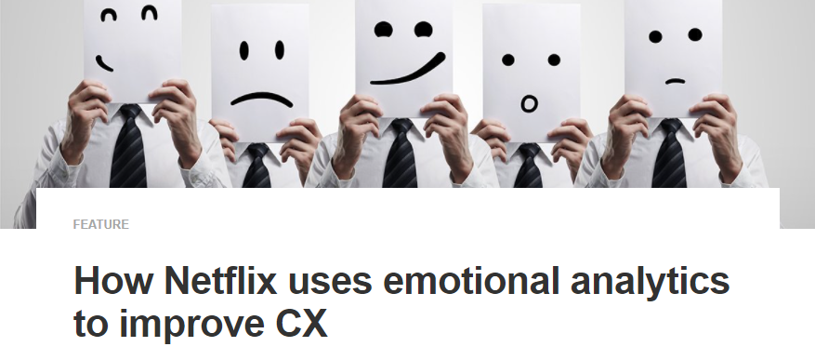
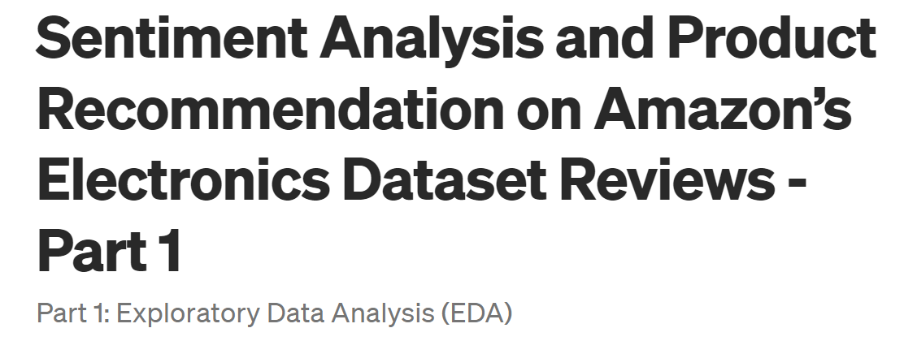
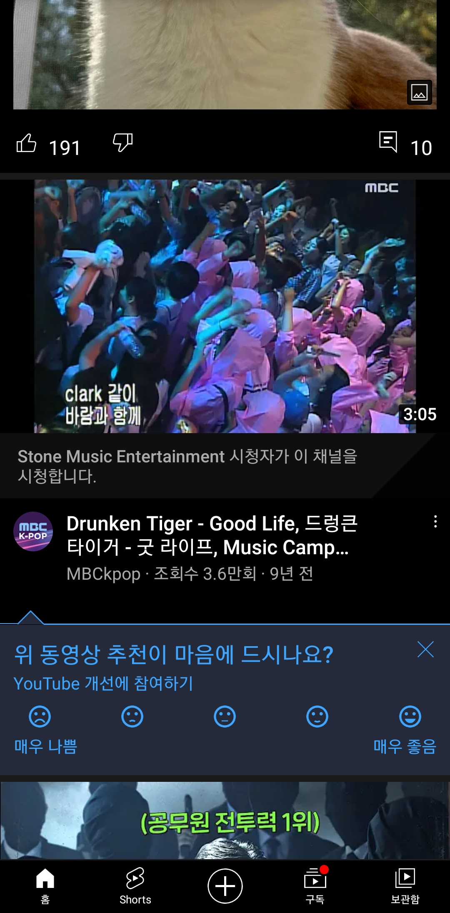
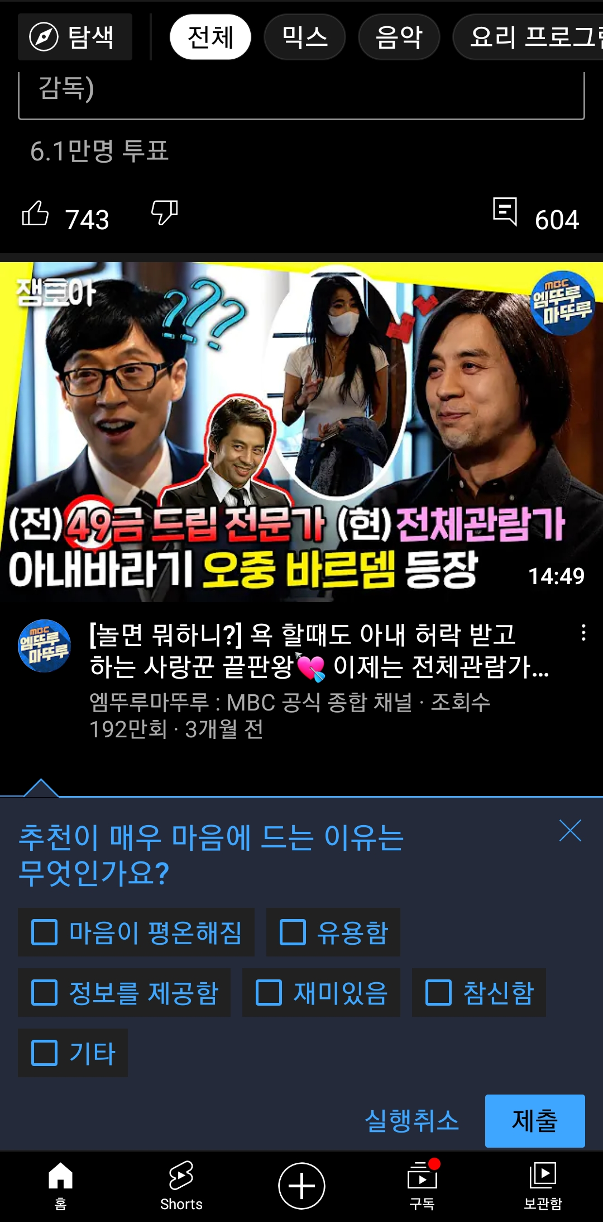
1. Industrial Cases
Industrial Cases of Sentiment/Emotion for Personalized Recommendation
Netflix
Emotional analytics to improve CX
Emotional analytics enable businesses to obtain customer feedback.
Amazon
Sentiment analysis on product review to reflect user’s experience
YouTube
YouTube Premium report requests customer feedback.
<Netflix>
<Amazon>
<YouTube>
Notes:
아마존: https://towardsdatascience.com/sentiment-analysis-and-product-recommendation-on-amazons-electronics-dataset-reviews-part-1-6b340de660c2

Slide 6
1. Background
Definition
Sentiment divides user’s positive and negative feelings into 5-levels. (Type: ordinal)
Emotion divides user’s psychological feelings into 6-levels. (Type: categorical)
0 | 1 | 2 | 3 | 4
Negative | Somewhat Negative | Neutral | Somewhat Positive | Positive
0 | 1 | 2 | 3 | 4 | 5
anger | fear | joy | love | sadness | surprise

Slide 7
1. Introduction – Research Question(RQ)
RQ1) Is it possible to improve performance by embedding affective Cinematic Experience in model?
RQ2) Which model performs the best rating prediction in algorithms such as traditional and graph model?

Slide 8
2. Related Work
Thank you

Slide 9
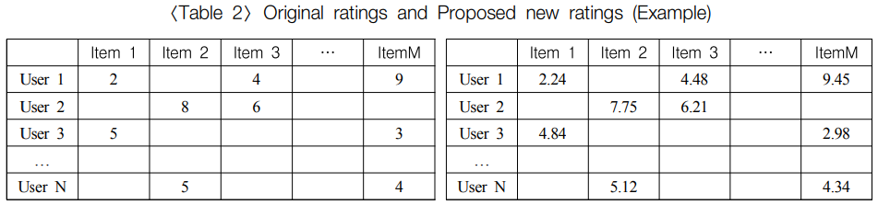
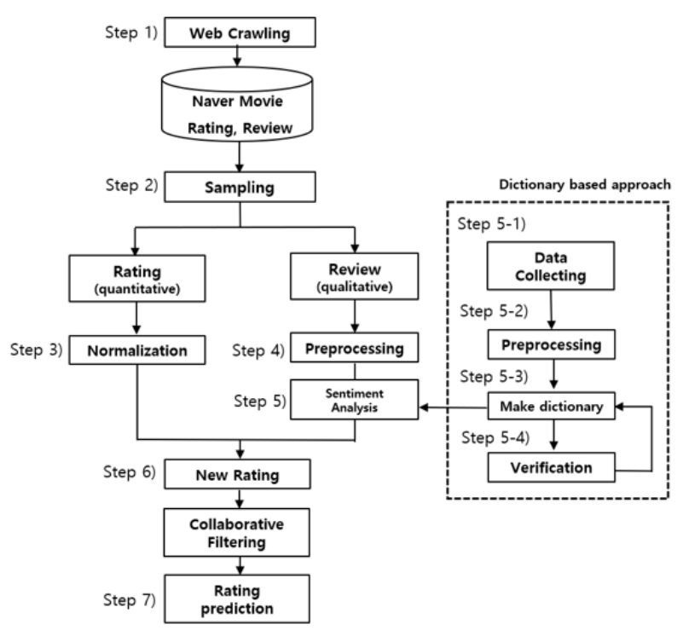
2. Related Work (cont’d)
Sentiment Analysis + RecSys
If the review is quantified, elaborate recommendations are possible.
Various analysis methods that were only possible with structured data are possible.
<Original ratings>
<New ratings>
<Overview of the proposed framework>
Reference: How to improve the accuracy of recommendation systems: Combining ratings and review texts sentiment scores (JIIS 2019)

Slide 10
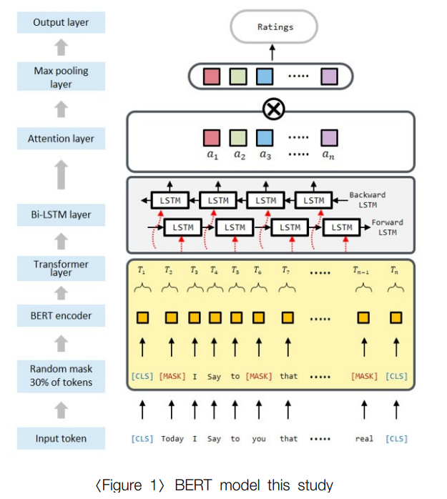
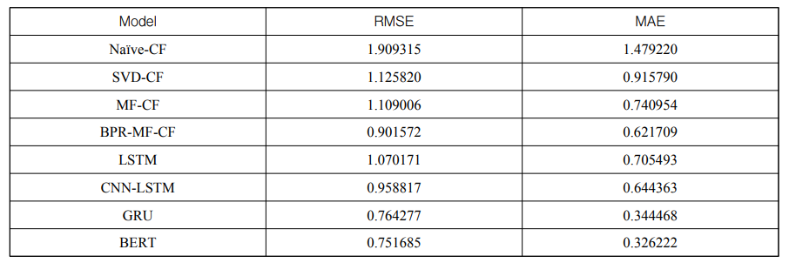
2. Related Work (cont’d)
BERT + RecSys
The BERT-based method is better than traditional methods.
The BERT-based method can proceed with sentiment analysis and recommendation at the same time, simplifying the recommendation process.
Output: rating
BERT
Input: review
< Framework based on BERT >
< Experimental results >
Reference: Recommender System Using BERT Sentiment Analysis (JIIS 2021)

Slide 11
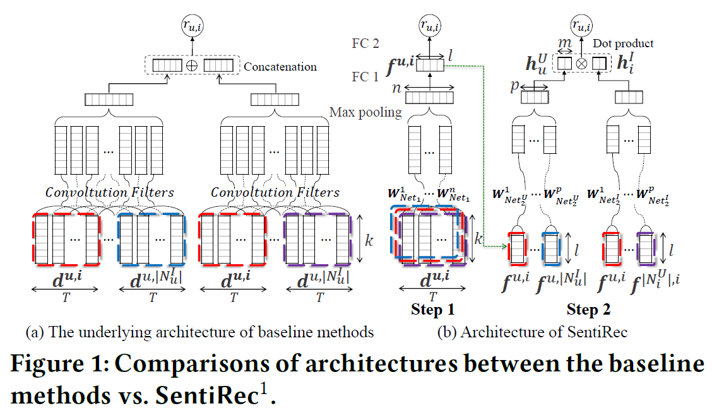
2. Related Work (cont’d)
Review Vector + RecSys
Review Sentiment–Guided Scalable Deep Recommender System (SIGIR 2018)
Review as a summarization of the overall sentiment of a user on an item
More accurate representations for reviews using CNN improve recommendation accuracy.
CNN
Review embedding
(user-based)
Review
Rating
Review embedding
(item-based)
<Overview of the proposed framework>

Slide 12
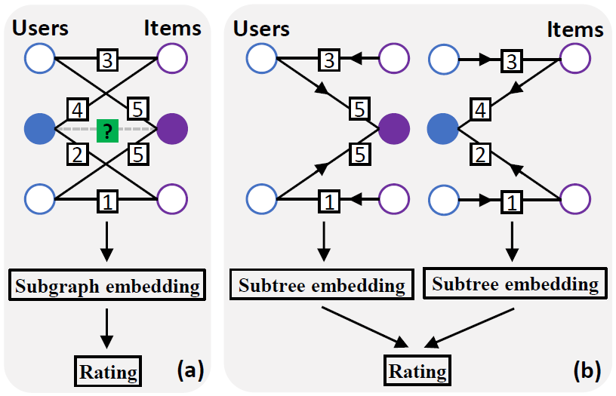
2. Related Work (cont’d)
GNNs for matrix completion
Node-level GNN: It cannot reflect the interactions between the two graphs.
Graph-level GNN: The learning is confined to the subgraphs.
<Node-level GNN>
ex) GCMC
<Graph-level GNN>
ex) IGMC
Reference: [11] Graph Convolutional Matrix Completion (KDD 2018)
Reference: [12] Inductive Matrix Completion Based on Graph Neural Networks (ICLR 2020)

Slide 13
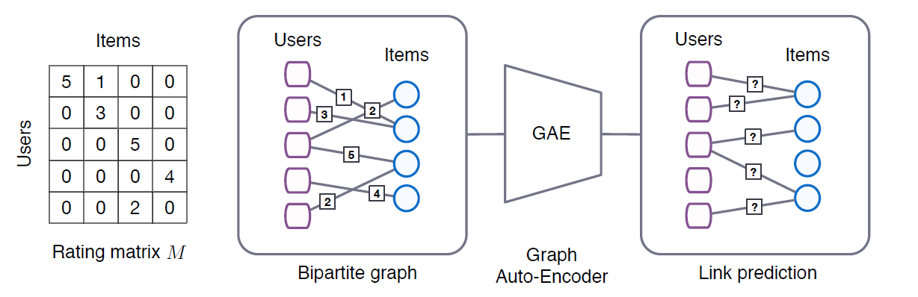
2. Related Work (cont’d)
Graph Convolutional Matrix Completion (KDD 2018)
In this paper, Graph auto-encoder framework predicts the ratings by expressing the rating matrix in a bipartite graph.
Better performance than conventional collaborative filtering(CF) techniques.
Graph model : GCN
Characteristics
Node-level embedding
Side-information needed
Reference: [11] Graph Convolutional Matrix Completion (KDD 2018)
Notes:
그래프를 단순 합으로 결합
Multi-layer로 구성하여 GNN 학습

Slide 14
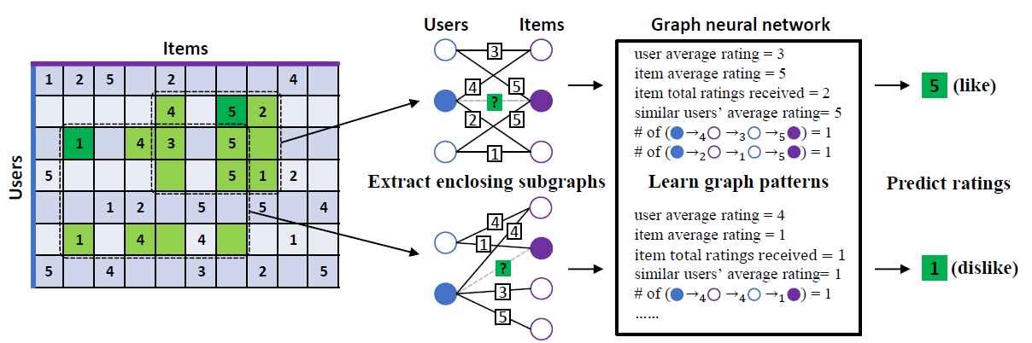
2. Related Work (cont’d)
Inductive Graph-based Matrix Completion (ICLR 2020)
The model that improved the shortcomings of GCMC
It is the state-of-the-art model among rating inference models using bipartite graphs.
Characteristics
Subgraph-level embedding
No side-information (author: future work!)
Users
Rating
Items
Subgraph
Embedding
Users
Rating
Items
1
3
2
3
3
4
5
4
5
?
5
2
5
2
5
1
1
Reference: [12] Inductive Matrix Completion Based on Graph Neural Networks (ICLR 2020)
Notes:
사이드 정보를 안쓰고 좋은 성능 보여주긴 했지만, 사이드정보를 쓰면 더 향상될 수 있다는 가능성을 남겨놨는데 얼마나 향상될지 특히, CX에 관련된 밝혀진바가 없다.
가장 좋은 sota모델에 CX를 접목시켜서 더 효과가 있는지를 보려했다.

Slide 15
3. Method
Thank you

Slide 16
3. Framework
Review
Sentiment
Subgraph
Encoder
Web
Crawling
Movie
Database
Emotion
MLP
Rating
Prediction
Raw Rating Score
Normalized
Rating Score
Aggregated
Embedding
Graph Model
Figure 1. Overview of proposed Framework

Slide 17
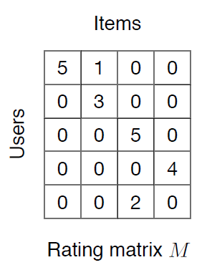
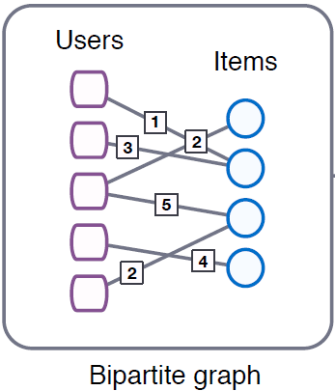
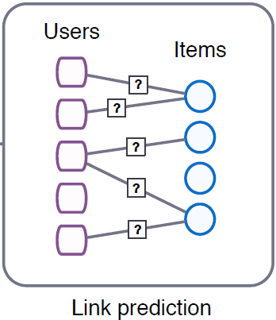
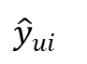
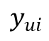
3. Baseline 1 (GCMC)
User features: top_critic, publisher_name
Item features: title, year, genres
Target
$$y_{ui}$$
User embedding
GCMC
Encoder
GCMC
Decoder
$${\hat{y}}_{ui}$$
Prediction
Item embedding
Reference: [11] Graph Convolutional Matrix Completion (KDD 2018)
Notes:
그래프를 단순 합으로 결합
Multi-layer로 구성하여 GNN 학습

Slide 18
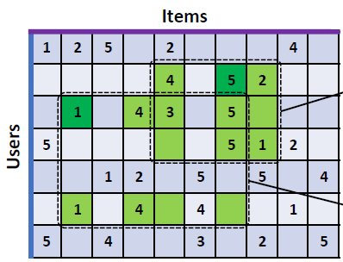
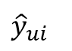
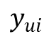
3. Baseline 2 (IGMC)
Target
Subgraph
Embedding
$$y_{ui}$$
Sub-bipartite graph
Users
Rating
Items
3
4
5
MLP
?
$${\hat{y}}_{ui}$$
2
5
Prediction
1
Reference: [12] Inductive Matrix Completion Based on Graph Neural Networks (ICLR 2020)

Slide 19
3. Framework 1 (GCMC + CX)
U | R | I
0 | 3.5 | 1
1 | 4.5 | 1
2 | 1.0 | 2
Target
$$y_{ui}$$
(Rating)
U | S | I
0 | 3 | 1
1 | 2 | 1
2 | 1 | 2
User embedding
GCMC
Encoder
GCMC
Decoder
$${\hat{y}}_{ui}$$
Prediction
Item embedding
(Sentiment)
U | E | I
0 | 5 | 1
1 | 2 | 1
2 | 3 | 2
(Emotion)

Slide 20
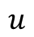
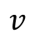
3. Framework 1 (GCMC + CX)
3
rating
rating (0-9)
1
12
1
sentiment
sentiment (10 - 14)
emotion
17
emotion (15 - 20)
2
0 | 1 | 1 | 0 | 1
0 | 0 | 0 | 1 | 0
1 | 0 | 0 | 1 | 0
1 | 1 | 1 | 0 | 1
1 | 0 | 0 | 1 | 0
2
18
3
1
3
4
4
11
Figure 5: Transforming multi-relational graphs to adjacent matrices

Slide 21
3. Framework 2 (IGMC + CX)
Subgraph
Embedding
Users
Rating
Items
3
Rating
4
5
?
Target
2
5
1
$$y_{ui}$$
Aggregated
Embedding
Users
Sentiment
Items
3
4
5
MLP
Sentiment
?
$${\hat{y}}_{ui}$$
2
5
Prediction
1
Users
Emotion
Items
3
Emotion
4
5
?
2
5
1
Notes:
그래프를 단순 합으로 결합
Multi-layer로 구성하여 GNN 학습

Slide 22
4. Experiment
Thank you

Slide 23
4. Experiment – dataset (Movie)
Dataset
Period : 1914.06.01 ~ 2020.10.31
Link : https://www.kaggle.com/stefanoleone992/rotten-tomatoes-movies-and-critic-reviews-dataset
Data
File name | Dimension | Columns
Movie data | (17713, 22) | 'rotten_tomatoes_link', 'movie_title', 'movie_info', 'critics_consensus', 'content_rating', 'genres', 'directors', 'authors', 'actors', 'original_release_date', 'streaming_release_date', 'runtime', 'production_company', 'tomatometer_status', 'tomatometer_rating', 'tomatometer_count', 'audience_status', 'audience_rating', 'audience_count', 'tomatometer_top_critics_count', 'tomatometer_fresh_critics_count', 'tomatometer_rotten_critics_count'
Review data | (1048576, 8) | rotten_tomatoes_link, critic_name, top_critic, publisher_name, review_type, review_score, review_date, review_content
Rating | Review | Amount | Rate
O | O | 758,709 | 67%
X | O | 305,502 | 27%
O | X | 65,372 | 5%
X | X | 434 | 0.03%

Slide 24
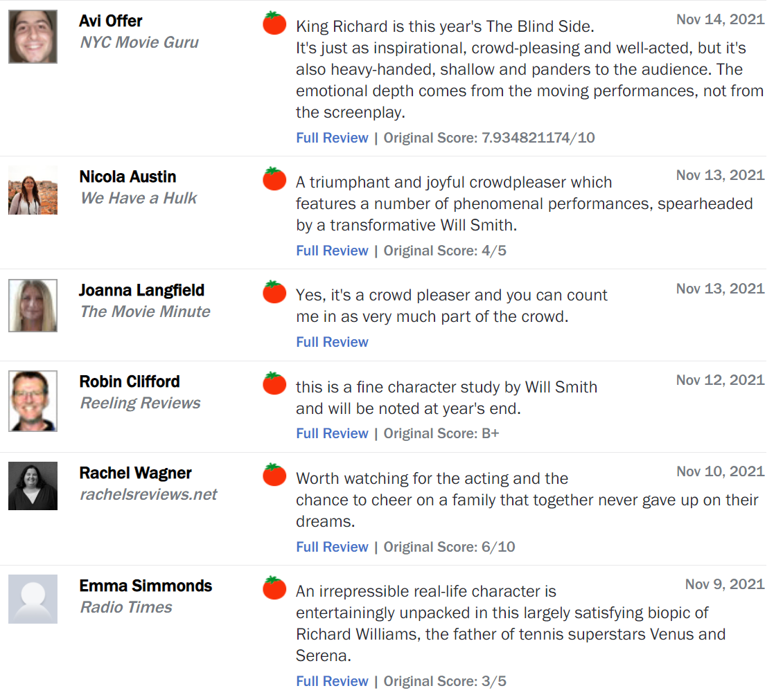
4. Why do you use Rotten Tomato data?
Features of rating score
Unlimited rating system
The need for data refinement
Data close to problems in the field

Slide 25
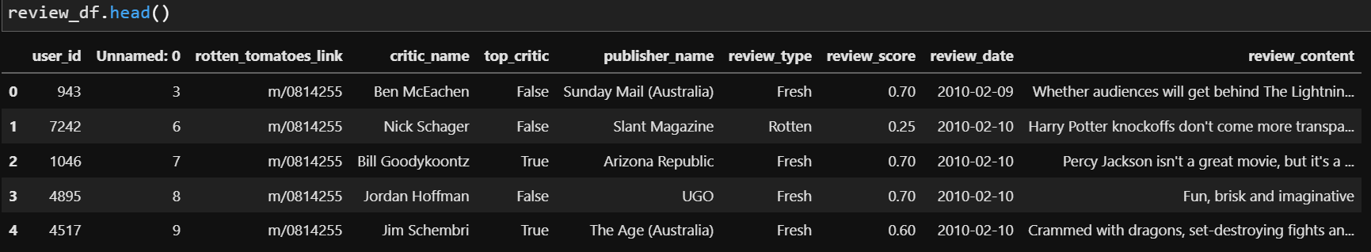
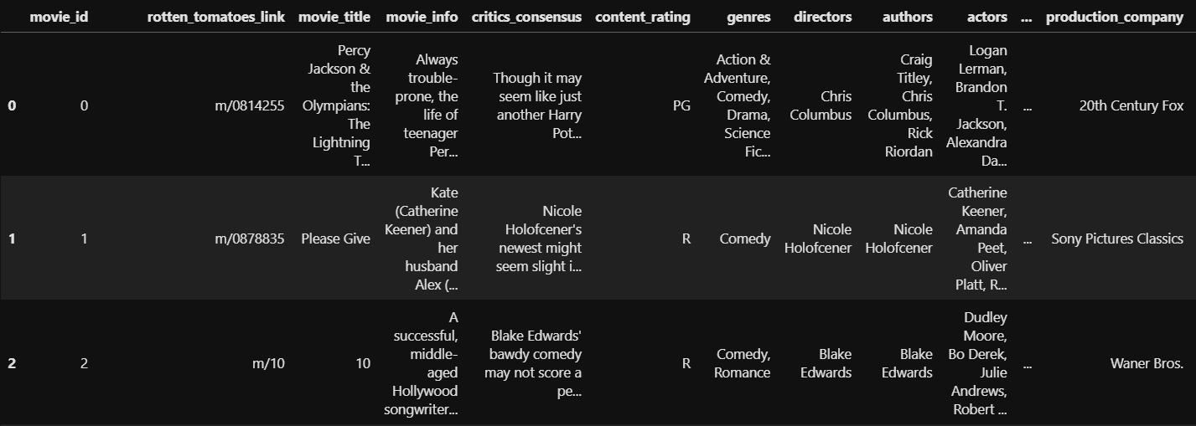
4. Experiment – dataset (Movie)
Dataset
Rating matrix
Group : critic_name, top_critic, publisher_name
The number of users : 9,794
Movie matrix
The number of movies: 17,614

Slide 26
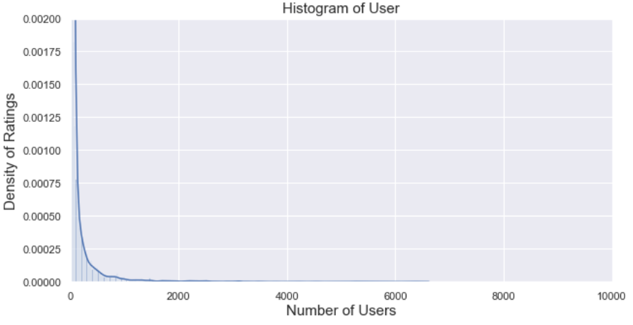
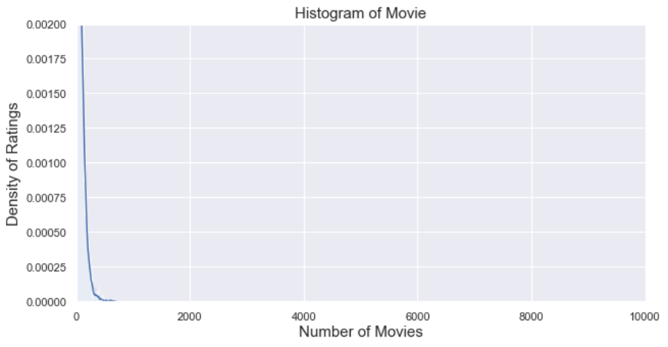
4. Experiment – dataset (movie)
Long-tail graphs
Group: User, Movie
Train/test rate = 9 : 1 (by timestamp)
Number: user_id(850), movie_id(6,805)
Exclude cold-start problem (user, item)
Range | User | Movie
Total | 9,794 | 17,614
< 3 | 3,552 (36%) | 993 (6%)
< 5 | 4,653 (48%) | 2,892 (16%)
>= 20 | 2,994 (31%) | 8,110 (46%)
>= 500 | 345 (4%) | 13 (0%)
Reviews >= 20
<User>
<Movie>

Slide 27
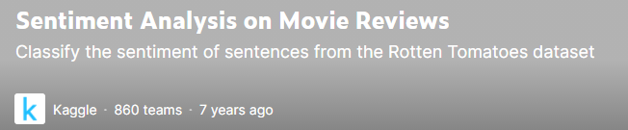
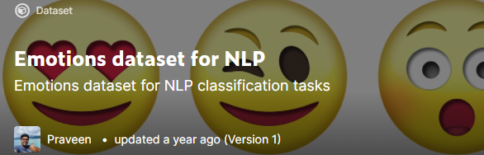
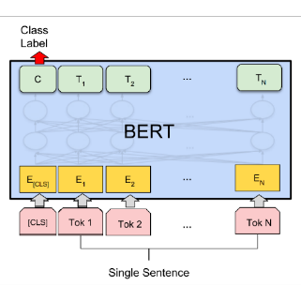
4. Experiment – dataset (sentiment, emotion)
Sentiment, Emotion dataset
Training data for BERT model in Kaggle
Sentiment[1]
Emotion[2]
Feature generating/augmentation using BERT fine-tuning
0 | 1 | 2 | 3 | 4
Negative | Somewhat Negative | Neutral | Somewhat Positive | Positive
0 | 1 | 2 | 3 | 4 | 5
anger | fear | joy | love | sadness | surprise
Review data
Result
U | E | M
0 | 1 | 1
1 | 3 | 1
2 | 2 | 2
Uma Thurman as Medusa, the gorgon with a coiffure of writhing snakes and stone-inducing hypnotic gaze is one of the highlights of this bewitching fantasy
Sentiment, emotion value
(graph)
[1] Sentiment Analysis on Movie Reviews
[2] Emotion dataset for NLP

Slide 28
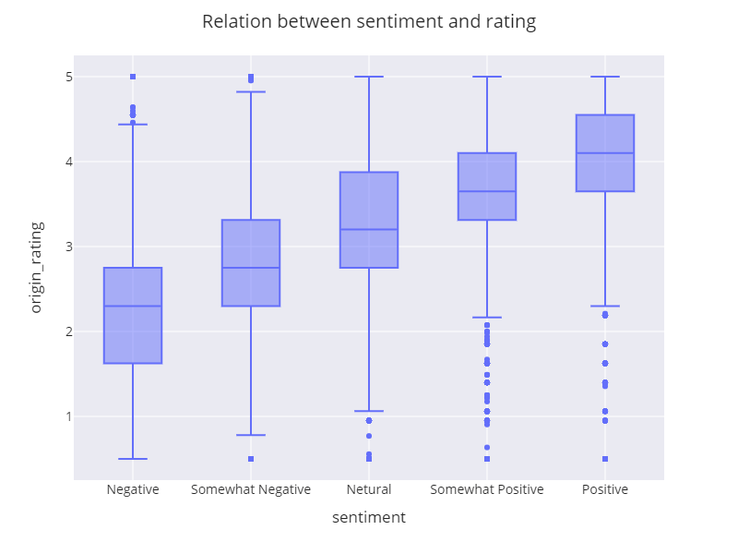
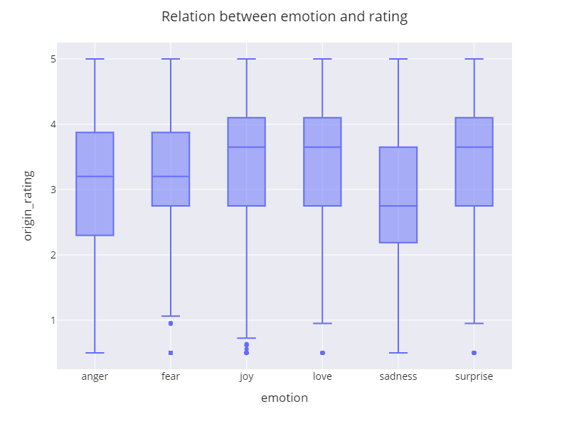
4. Experiment – Correlation graph
Relation between rating and sentiment/emotion
Figure 7: Relation between sentiment and rating
Figure 8: Relation between emotion and rating

Slide 29
4. Grid search
Grid search
Conventional models
Models : KNNWithMeans, SVD, and SVDpp (Surprise library)
Hyperparameter
KNNWithMeans : k(10,15, 25), name(Pearson_baseline, Cosine)
SVD, SVDpp : learning_rate(0.005, 0.006, 0.007)
GCMC based modes
Hyperparameter
Dimensions : 75, 150, 225
Drop out : 0.3, 0.5, 0.7
Learning rate : 0.005, 0.01, 0.02, 0.03

Slide 30
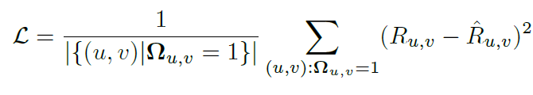
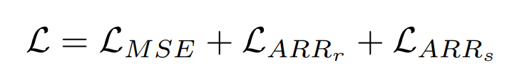
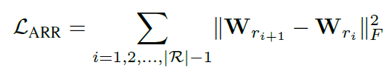
4. Loss definition in IGMC
Model Training
Mean Square Error(MSE) Loss
Adjacent Rating Regularization(ARR) Loss
Each rating uses a different weight matrix, and the weight of a nearest rating should be more similar than the weight of a distant rating.
Frobinous normal loss is taken to the weight of the adjacent rating.
ex) In rating(1,2,3,4,5), 4 is closer to 5 than 1.
<MSE Loss>
<New Loss>
<ARR Loss>

Slide 31
5. Results
Thank you

Slide 32
5. Result Table
Model | RMSE | MAE
CF (user-based) | 0.9233 | 0.7321
CF (item-based) | 0.8818 | 0.6851
SVD | 0.8425 | 0.6594
SVD++ | 0.8328 | 0.6502
GCMC (feature X) | 0.8207 | 0.6457
GCMC | 0.8135 | 0.6401
GCMC (+ CX) | 0.8070 | 0.6359
IGMC | 0.8051 | 0.6306
IGMC (+ CX) | 0.8004 | 0.6242
Table 1: RMSE results

Slide 33
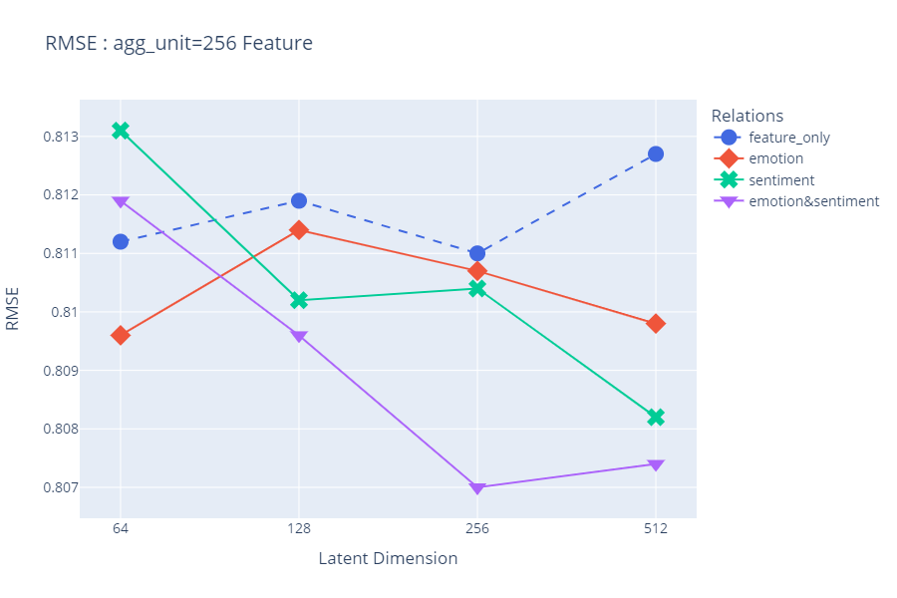
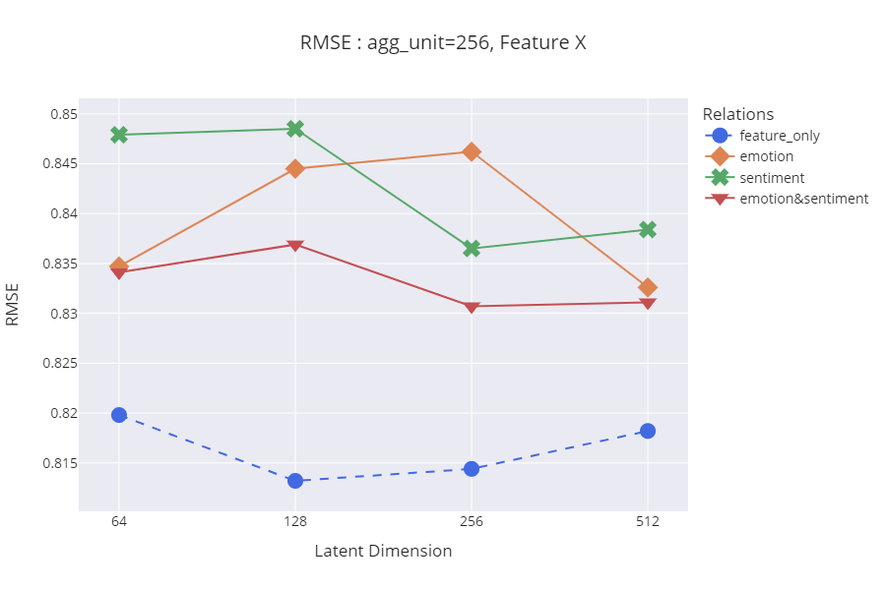
5. RMSE Graph of GCMC
Figure 9. RMSE graph of GCMC comparing dimensions with node features

Slide 34
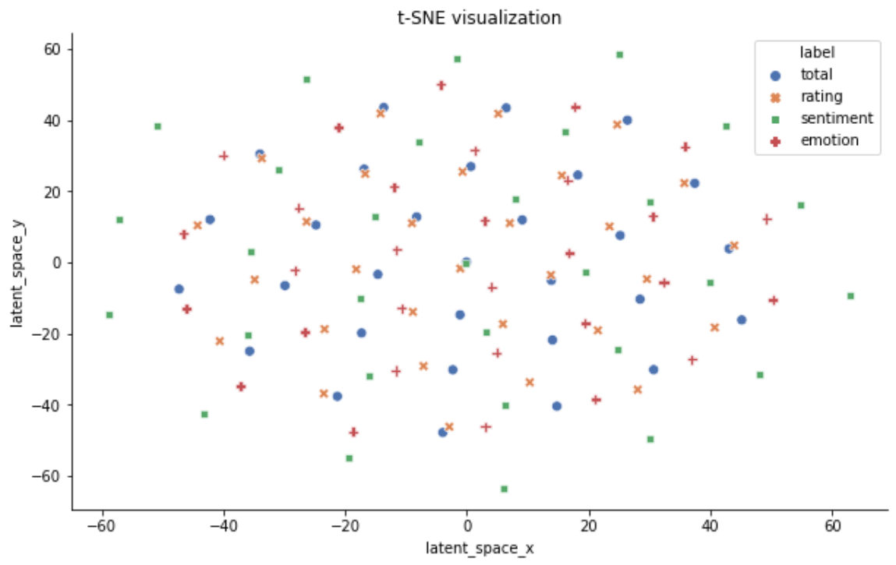
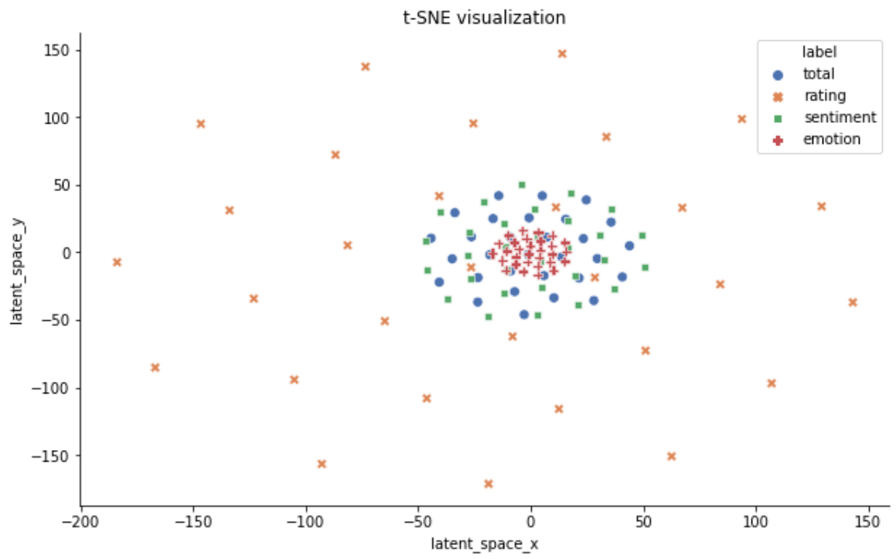
5. t-SNE of IGMC
(Worse performance)
(Better performance)
Figure 10. t-SNE of IGMC

Slide 35
6. Discussion
Thank you

Slide 36
6. Discussion
Implications
Information not reflected in the rating may be extracted from the review data.
When CX information is combined with a rating, it is possible to improve the performance of the recommender system.
The industry of the recommender system also uses CX information for personalized recommendation.
Limitations
Information explicitly extracted from the review data was only used as features.
Improved performance but, high time-complexity
Future Work
If the review itself is embedded, more richer information will be reflected in the vector.
Recently, graph-based research has attracted a lot of attention, and in the future, studies that reflect CX in graphs will emerge.

Slide 37
7. Conclusion
Thank you

Slide 38
7. Conclusion
Natural language information can be used in a graph-based recommender system through a method of stacking BERT.
Using both ordinal data like sentiment and categorical data like emotion can also improve the performance of the model.
GNN-based recommendation is better than traditional methods because the graph reflects the multi-relational information between users and items.
The CX information can be aggregated in subgraph embedding.
Multi-relational graphs can be reflected in the IGMC in the manner we propose, and multi-relations can be replaced by other meta-information between users and items.

Slide 39
Thank you
Thank you

Slide 40
Appendix
Thank you

Slide 41
4. Experiment Condition – IGMC
Hyperparameter (default)
Hop : 1
Max_nodes_per_hop : 100
Edge_dropout : 0.2
Train_lr : 1e-3
Train_min_lr : 1e-6
Train_lr_decay_factor : 0.1
Train_lr_decay_step : 50
Train_epochs : 20
Batch_size: 16
Arr_lambda : 0.001
Num_rgcn_bases : 4

Slide 42
2. Related Work (cont’d)
Emotion Analysis
[1] The impact of emotions on the helpfulness of movie reviews (JART 2015)
[2] Tensor-based tag emotion aware recommendation with probabilistic ranking. (KSII 2019)
[3] Item recommendation using tag emotion in social cataloging services. (ScienceDirect 2017)
[4] Using Affective Features from Media Content Metadata for Better Movie Recommendations (KDIR 2020)
Detect movie overviews’ implicit affective features like emotion and sentiment.
Strength: reflect dynamic information like user’s emotion and sentiment
Sentiment Analysis
[5] Review Sentiment-Guided Scalable Deep Recommender System (SIGIR 2018)
[6] How to improve the accuracy of recommendation systems: Combining ratings and review texts sentiment scores. (JIIS 2019)
[7] The impact of emotions on the helpfulness of movie reviews (JART 2015)
There is a correlation between emotions about the movie reviews and satisfaction.
[8] Integrating Collaborative Filtering and Sentiment Analysis : A Rating Inference Approach (ECAI workshop 2006)
Approach sentiment analysis with statistical techniques
[9] BERT 기반 감성분석을 이용한 추천시스템 (KCI 2021)
Comparing Emotional Analysis with ML/DL Techniques and Presenting the Performance of BERT
Limitation : rating inference was only carried out, and explainable recommendation is not possible.
[10] Movie Recommendation System Using Sentiment Analysis From Microblogging Data (IEEE transactions on computational social systems 2020)
Hybrid RS from collaborative filtering(CF) and content-based filtering(CBF) along with sentiment analysis

Slide 43
2. Related Work
Graph Neural Network
[10] Semi-Supervised Classification with Graph Convolutional Networks (ICLR 2017)
GCMC-based
[11] Graph Convolutional Matrix Completion (KDD 2018)
[12] Inductive Matrix Completion based on Graph Neural Networks (ICLR 2020)
[13] Inductive Matrix Completion Using Graph Autoencoder (CIKM 2021)
[14] AIRC: Attentive Implicit Relation Recommendation Incorporating Content Information for Bipartite Graphs (MDPI 2020)
Multi-layer graphs
[15] Community Detection in Multi-Layer Graphs: A Survey (SIGMOD 2015)
Link-prediction and GCN
[16] Link Prediction Based on Graph Neural Networks (NIPS 2018)
[17] Web Service Network Embedding based on Link Prediction and Convolutional Learning (IEEE Transactions on Services Computing)
Bi-partite graph
[18] Bipartite graph partitioning and data clustering (CIKM 2001)
[19] Metadata-Based Collaborative Filtering Using K-Partite Graph for Movie Recommendation (EDB 2012)
[20] Domain Knowledge-Based Link Prediction in Customer-Product Bipartite Graph for Product Recommendation (IJIT & DM 2019)

Slide 44
3. Framework1 – Before Encoding
rating
2
3
3
sentiment
emotion
3
rating
12
sentiment
item
emotion
 |  | 0
 |  | 1
 |  | 0
17
user
Figure 2: multi-relational graph
rating 2
rating 3
rating 4
Figure 3: Graphs and adjacent matrices
for user 2 and movie 3 about rating edge
Notes:
그래프를 단순 합으로 결합
Multi-layer로 구성하여 GNN 학습

Slide 45
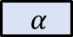
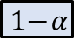
Explicit CX Embedding 3
Subgraph
Embedding
Users
Rating
Items
3
Rating
4
5
?
2
5
Target
1
$$y_{ui}$$
New
Embedding
Users
Sentiment
Items
3
4
5
MLP
Sentiment
?
$$α$$
$${\hat{y}}_{ui}$$
2
5
Prediction
1
Users
Emotion
Items
3
[Aggregation Functions]
Mean
Sum
Avg
Concat
Emotion
4
5
?
$$1−α$$
2
5
1
Notes:
그래프를 단순 합으로 결합
Multi-layer로 구성하여 GNN 학습

Slide 46
3. Framework
Step 3)
Step 4)
Step 5)
Step 6)
Review
Sentiment / Emotion
Graph
Model
Explicit CX Embedding
Step 1)
Step 2)
Step 7)
Step 8)
Web
Crawling
Movie
Database
Review Vector
Ensemble
Rating
Prediction
Rating
Rating
(normalization)
Implicit CX Embedding
Figure 1. Overview of G-CXE Framework

Slide 47
Baseline (IGMC) + IDEA : G-CXE
Target
Subgraph
Embedding
$$y_{ui}$$
Sub-bipartite graph
Users
Rating
Items
3
4
5
MLP
?
$${\hat{y}}_{ui}$$
2
5
Prediction
1
Review
Explicit CX Embedding
Implicit CX Embedding
Uma Thurman as Medusa, the gorgon with a coiffure of writhing snakes and stone-inducing hypnotic gaze is one of the highlights of this bewitching fantasy
Notes:
그래프를 단순 합으로 결합
Multi-layer로 구성하여 GNN 학습

